Slide 1
How to be the Best Math Tutor
Ms. Smith

Slide 2
What will we cover today?
Topics:
Tips To Tutor Math
How to help with Test Corrections
Common Teaching Methods at EG
How to tackle those word problems
Find the mistake

Slide 3
Tips to Tutor Math
Tips:
Always re-look at the problem
Ask the student to explain their logic
Keep the pencil or stylus in the student’s hand
Explain the process do not simply give the right answer

Slide 4
Tips to Tutor Math
Tips:
5. Have the student explain the process back to you
*Try not to ask, “Do you understand?”
6. Have the student try a different problem
7. Ask the student to show you their notes for the teaching style

Slide 5
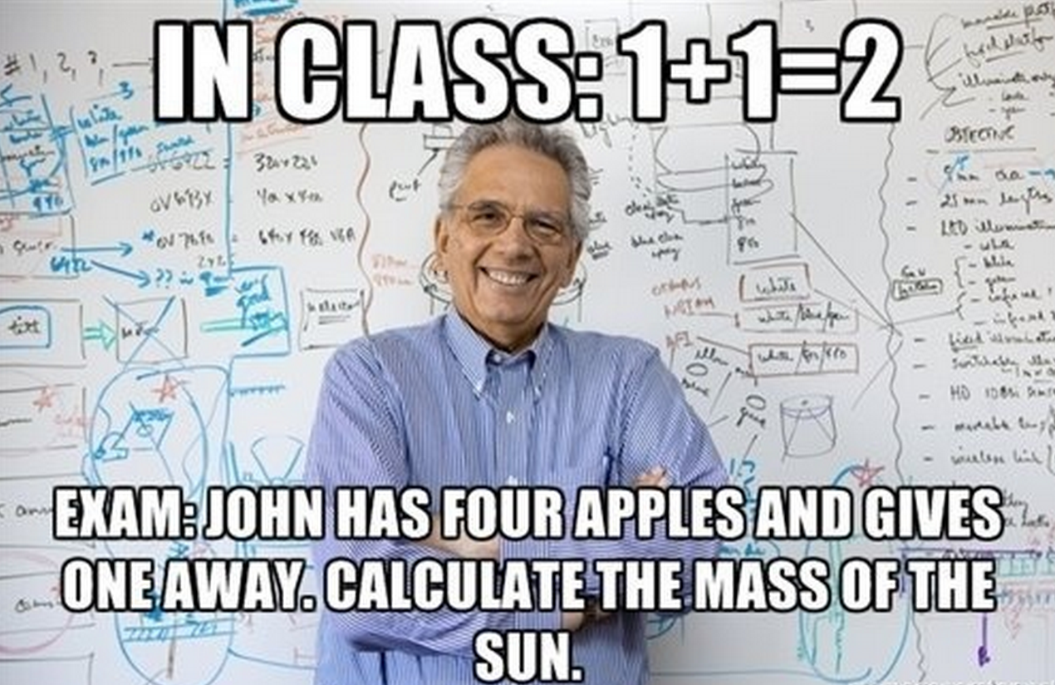
Tips to Tutor Math
Remember to keep math anxiety in mind! How do you like to get help?

Slide 6
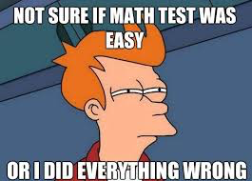
How to Help with Test Corrections
Test Corrections
Start with a new sheet of paper unless the topic is graphing
Look over the students work to determine if it was a small mistake
Sign the top when done
Regular and Prep level
can use a calculator

Slide 7
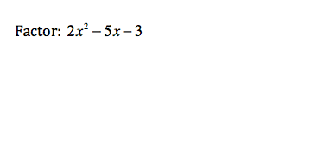
Common Methods at EG
Factoring

Slide 8
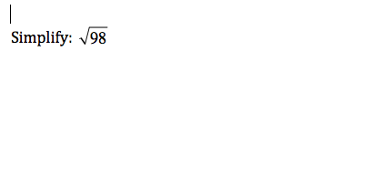
Common Methods at EG
Simplifying Square Roots

Slide 9
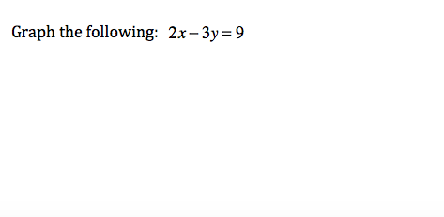
Common Methods at EG
Graphing Linear Equations

Slide 10
Word Problems

Slide 11
What does it look like?

Slide 12
Questions?

Slide 13
Which student solved it correctly?

Slide 14
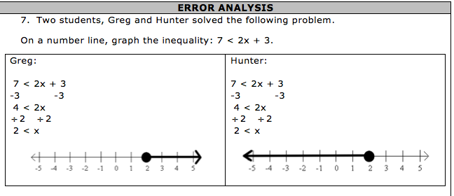
Which student solved it correctly?

Slide 15
Which student solved it correctly?

